Slide 1

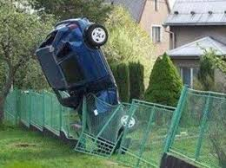
NYC Vehicular Accidents
Presented by
Kyle Rushing & Hayden Mann

Slide 2

Identify problematic streets in New York City where accidents or fatal crashes occur.
Problem Statement

Slide 3
Dataset Features
Locations
Time Features
Crash Severity
Context
Longitude
Latitude
Zip
Street Name
Borough
Date
Hour
Day of Week
Month
Injury
Fatality
Vehicle Type
Nature of the Driver(aggressive driving, drunk, etc.)

Slide 4
Data Cleaning
01
02
03
Removed Unused Data
Condensed Columns
Added New Columns
Vehicle type columns
Date
Vehicle type
Nature of crash
Day of week
Hour
Month
Location

Slide 5
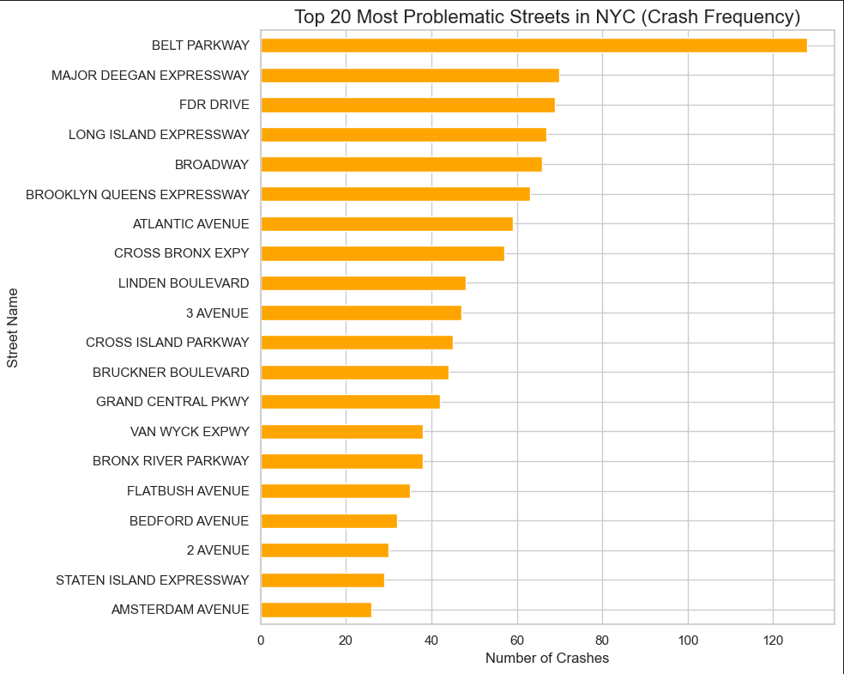
The number of crashes on each street.
Most Problematic Streets

Slide 6
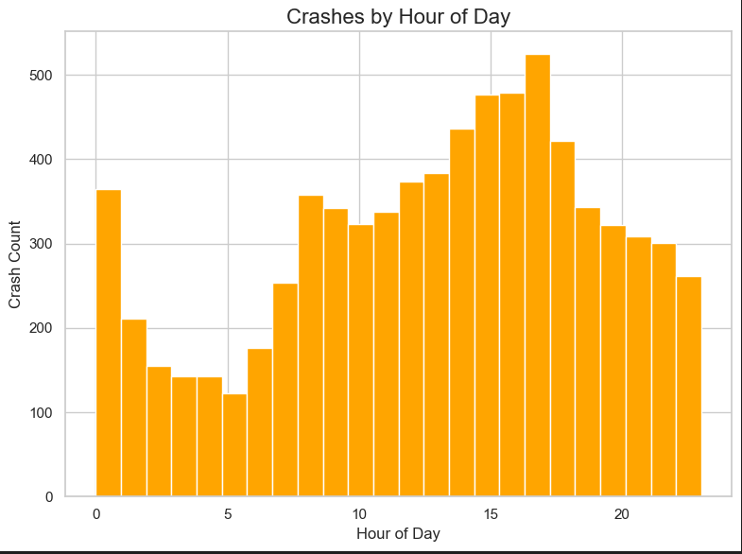
The time which crashes have occured.
Crashes by Hour of Day

Slide 7
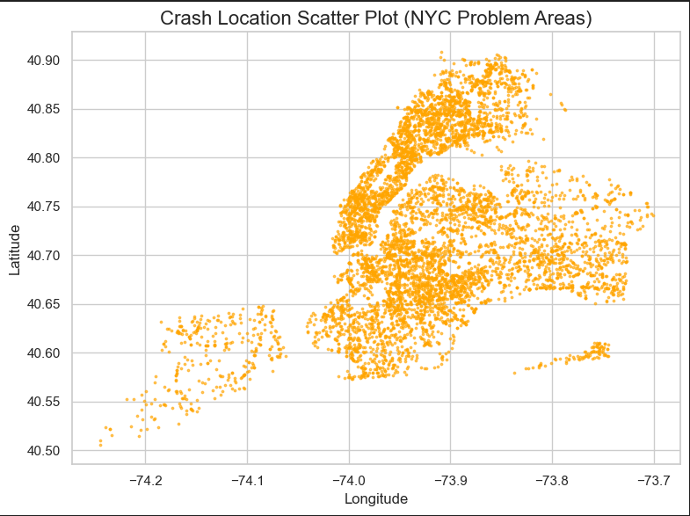
Location of crashes based on longitude and latitude.
Scatter Plot

Slide 8
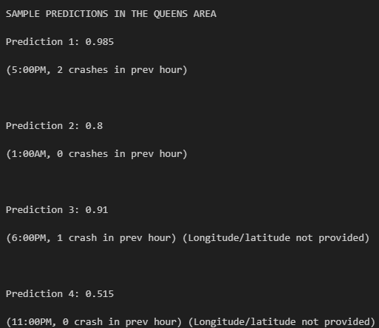
Model allows the prediction of a crash based on location, time, and previous crash history.
Built to be cautious, as a result percentages are somewhat inflated due to false positives.
Prediction Model

Slide 9
Problem Streets
Belt Parkway
Brooklyn-Queens Expressway
FDR Drive
Queens Boulevard
Peak Crash Time
Between 3-6 PM
Hotspot Regions
Highway Corridors
Bridge Approaches
Dense Urban Roads
Key Resources Used
VS Code
MySQL
Github
Discord
Data.gov
Solution
Speed bumps
Extra lanes
Stop signs
Conclusion

Slide 10
Thank you for listening

